Slide 1
Fitting dimension(cases) reduction techniques(HCA & K-mean)
Tilak Poudel
39

Slide 2
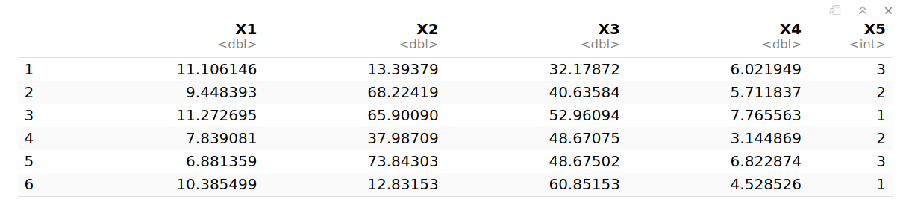
Code used to generate 500 random data with five variables where one of the variables must be defined as binary factor (0 and 1) dependent variable for Roll 1-10 models and categorical factor (1, 2 and 3) dependent variable for Roll 11-20 models
Fit dimension (cases) reduction techniques i.e. HCA and k-means and selecting the best model for this data with careful interpretations of the cluster plots
Data generation
set.seed(39)
# Generate the data
data <- data.frame(
X1 = rnorm(500, mean = 10, sd = 2),
X2 = runif(500, min = 0, max = 100),
X3 = rnorm(500, mean = 50, sd = 10),
X4 = runif(500, min = 2, max=8),
X5 = sample(1:3, 500, replace = TRUE)
)
# View first few rows
head(data)
dim(data)
> print(dim(data))
[1] 500 5
I am setting the seed to 39 to ensure reproductivity. And created a dataframe with 500 rows and 5 columns. rnorm, runif and sample are used to generate data.

Slide 3
2. Dimension reduction with HCA(Hierarchical Cluster Analysis)
Before fitting the model (k-means) we need to know the value of k. So used HCA to find the best value if k.
data.similarity <- dist(data)
hirar.2 <- hclust(data.similarity, method='complete')
hirar.2
plot(hirar.2, labels=rownames(data), ylab="Distance")
Used cluster method complete and euclidean distance to find the distance between the data.
Thereafter plotted to obtain the dendogram.

Slide 4
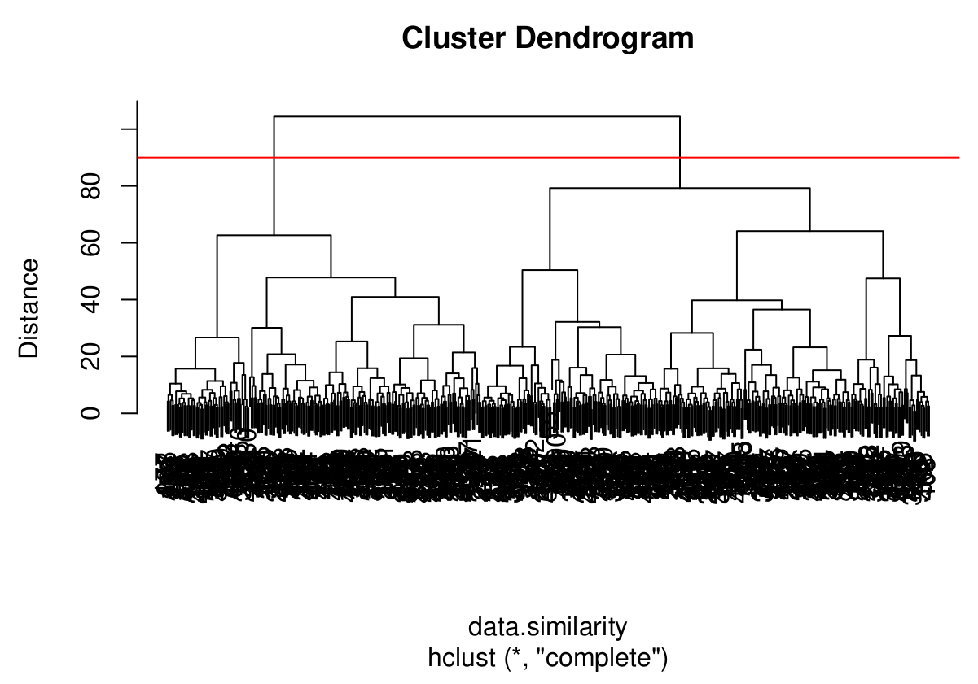
abline(h = 90, col = 'red')
Observing the dendrogram we can have a cut at distance 90 to obtain the value of k as 2. This k value can be used in k-means clustering.

Slide 5
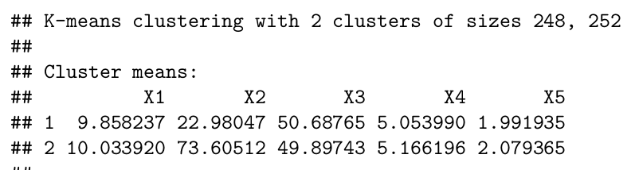
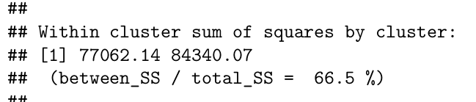
3. Fit the model K-means with k = 2
set.seed(39)
kmeans_model <- kmeans(data, centers=2, nstart = 20)
kmeans_model
Then fit the k-means model with k = 2 and nstart = 20.
66.5% of the total variance is between clusters.

Slide 6
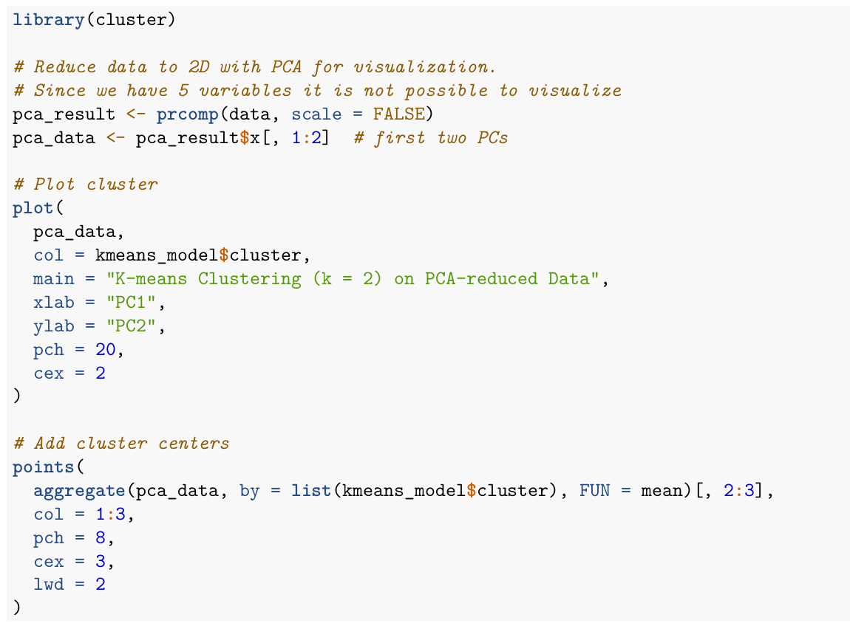
Plot the cluster

Slide 7
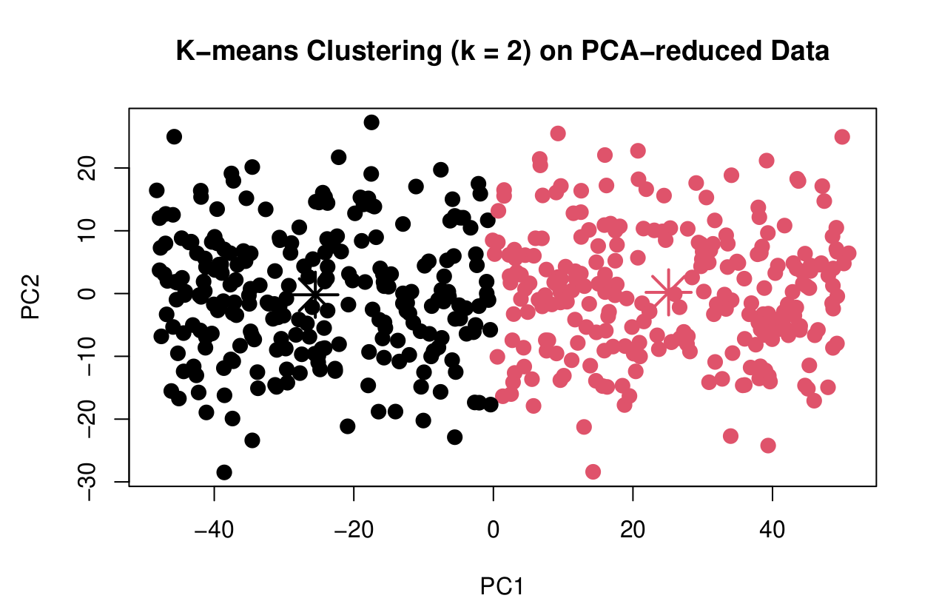

Slide 8
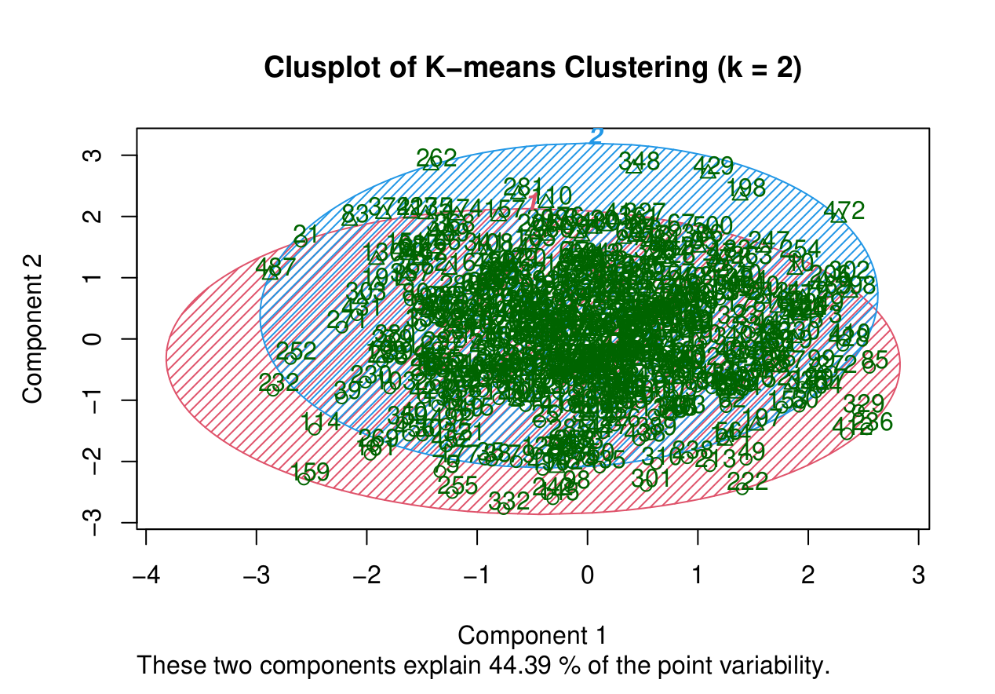

Slide 9
Performance metrics
There is no traditional "model accuracy" as in supervised classification, we can use internal validation metrics:
Total Within-Cluster Sum of Squares (WSS)
Lower is better — measures compactness.
Between-cluster SS / Total SS (%)
Higher is better — shows separation between clusters.
Silhouette Score (Preferred Internal Metric)
Ranges from -1 to 1. Higher = better clustering.
kmeans_model <- kmeans(data, centers=2, nstart = 20)
> kmeans_model
library(cluster)
sil <- silhouette(kmeans_model$cluster, dist(data))
mean(sil[, 3]) # Average silhouette width
Within cluster sum of squares by cluster:
[1] 77062.14 84340.07
(between_SS / total_SS = 66.5 %)
[1] 0.5304015

Slide 10
Thank You

